Slide 1
The Necklace
Background & Author

Slide 2
Author: Guy de Maupassant
Born in 1850 with both parents
Mother later took full custody and raised them alone
She home-schooled the brothers until Guy was sent to a seminary (religious school)
He was expelled for rebelling
Went to law school
50+ pieces of writing
Attempted suicide and eventually passed in a private asylum

Slide 3
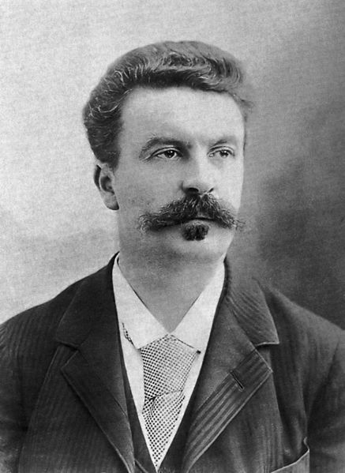
Time Period
Franco-German War
The story The Necklace, takes place in France
A woman’s life was dictated by her income and family
Family she was born into (father’s status) and married into (husband’s status)
The only way she could change her situation was to marry into a different class
Woman expected to answer to man and he is in charge of her along with all of her possessions

Slide 4
Hierarchy of social classes
Wealthy
Life filled with luxury
More power over other classes and people
Upper Class
Women were expected to find happiness in taking care of family
Modest home and living
Middle Class
Poverty
Life filled with work and struggle
No power
Lower Class

Slide 5
Questions to consider…
Who is the protagonist?
What do you learn about the characters, setting, and situation in the exposition or introductions of the story?
What she wants/ deserves
What she has

