Slide 1
The most dangerous game notes
Yes you have to write this down

Slide 2
The time period
The Most Dangerous Game was published in 1924
The 1920s were also known as The Roaring Twenties because many changes were occurring in society from coast to coast
The radio was invented and could be found in just about every household
The car became the most important consumer product (approx. $240 for a Ford)
Women were granted the right to vote with the 19th amendment
The prohibition closed all bars, taverns, and other establishments whose sole purpose was to serve alcohol.

Slide 3
Extras
More people were moving into the cities instead of farms, and spending money on consumer goods
Hobbies included spending money and shopping
Those who had more money hunted as a sport/ hobby

Slide 4
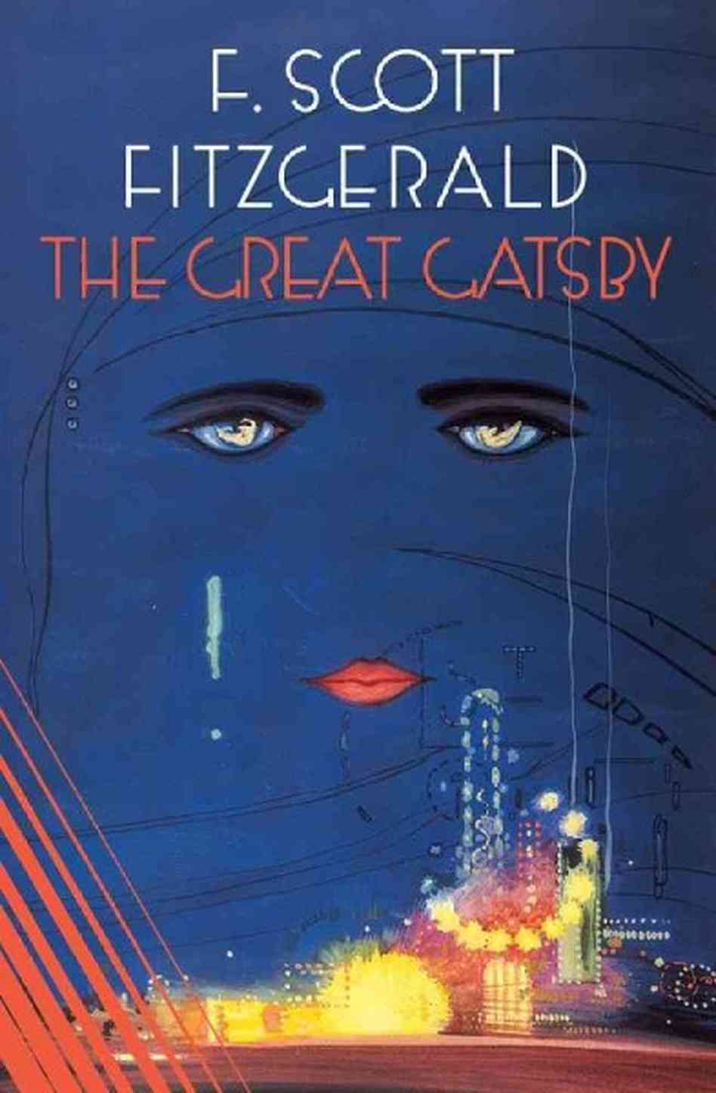
Major Publishing's
The Great Gatsby by F. Scott Fitzgerald
The Sun Also Rises by Ernest Heminway
Mrs. Dalloway by Virginia Woolf
The Sound and the Fury by William Faulkner

Slide 5
The short story
The Most Dangerous Game by Richard Connell
You need one sheet of paper, and your short story.

