Slide 1
Elements of Literature

Slide 2
Response & Share
Write at least 4-5 sentences reflecting on the following quote: “The harder the conflict, the more glorious the triumph.” – Thomas Paine

Slide 3
The 5 Elements of Literature
https://www.youtube.com/watch?v=c6I24S72Jps
Character: a person, sometimes animal, who takes part in the action of the short story or other literary work
Setting: the time and place in which it happens.
Using descriptions of scenery, buildings, seasons, landscapes, etc.
Plot: a series of events and character actions that relate to a central conflict.
Conflict: a struggle between two people or things in a short story.
The main character is usually on one side of the conflict, struggling against another main character
Theme: central idea or belief in a short story

Slide 4
Short Stories
Short story: a story that is fully developed in theme, but shorter than a novel and read in one sitting
Generally, has one conflict with the protagonist to keep the story moving and interesting
Exposition: beginning and first part of the story
Sets the tone for the rest of the story
Establishes the setting, introduces characters, provides important background information

Slide 5
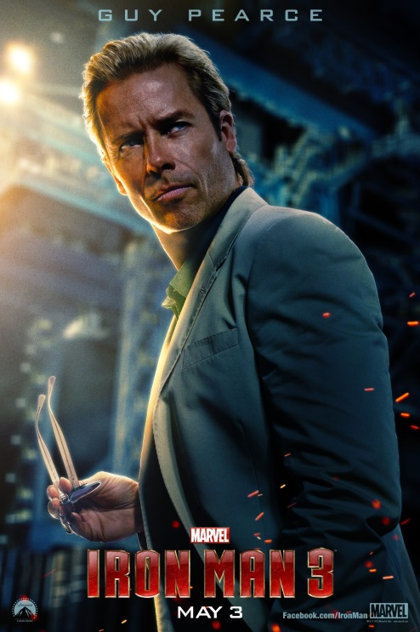
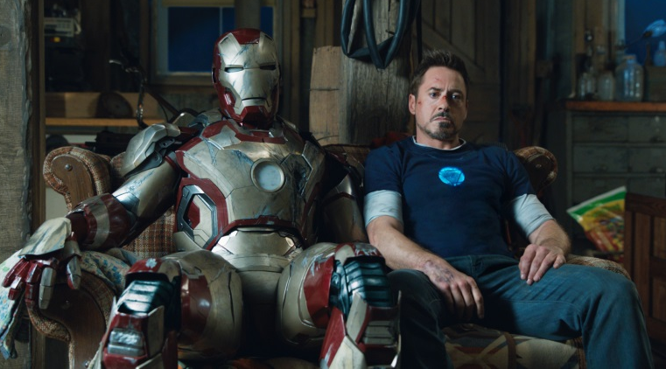
Characters
Characterization: the way a writer develops a character’s personality and traits
Protagonist: the main character of the story
Antagonist: whoever or whatever the main character struggles against or has a conflict with

Slide 6
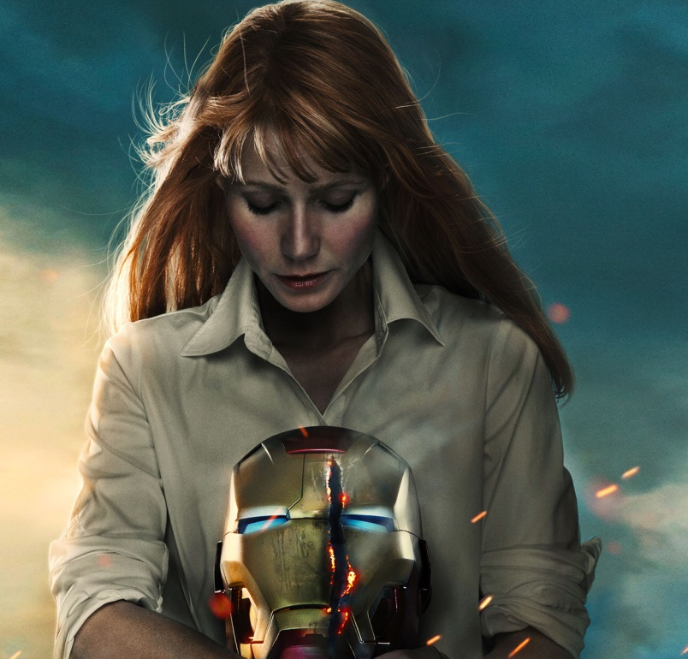
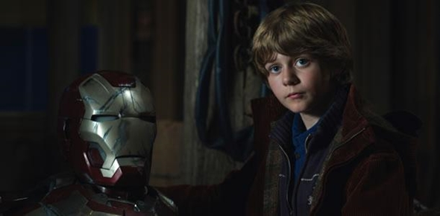
Characters cont.
Dynamic characters: main characters that undergo changes as the plot unfolds
Static characters: unaffected by changes and remain the same throughout the plot

Slide 7
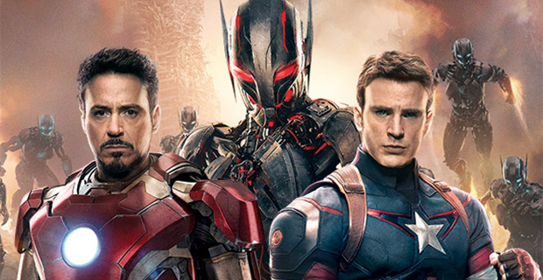
Types of Conflict
External Conflict
Involves a character against another force of nature or another character
Person vs. person
Person vs. nature
Person vs. supernatural
Person vs. machine/ technology
Internal Conflict
occurs within the character itself
Person vs. self
Mind wants to do one thing but body wants to do another

Slide 8
Terms to Know
Irony: the expression of one’s meaning by using language that normally signifies the opposite
Pun: a joke playing on the different meanings of a word or how words sound alike.
Ex: She had a photographic memory but never developed it.
Suspense: feeling anxious/ excited because of uncertainty of what is about to happen
Foreshadowing: warning of a future event

Slide 9
Terms to Know cont.
Analysis: detailed examination of the elements or structure of something
Interior Monologue: writing expressing a character’s inner thoughts
Symbolism: the use of symbols to represent ideas or qualities
Ex: Wearing the “A” in the Scarlet Letter and in the movie Easy A
Rising Action: events that move the plot along and builds to the climax

Slide 10
Terms to know cont.
Climax: turning point and the moment when the reader’s interest reaches the highest point
Falling Action: events that begin to conclude or lead to the resolution
Usually at the end of the story
Diction: writer’s word choice
Dialogue: written conversation
Flashback: reflects back at something that happened at the beginning of the story or occurred outside of the story that the reader did not know
Interrupts the flow

Slide 11
Terms to know cont.
Symbolism: a person, place, thing, or event that stands for itself and also represents something else
Inference: when the reader can make a logical guess about a story based on the information in the story or common sense
Figurative language: refer to handout with different types

Slide 12
Due at the end of class TODAY
Write two paragraphs, sharing a time where you experienced a conflict
Tell me a little bit about the situation, what happened, and how you resolved it/ handled the situation.
What did you learn from the situation?
Is it still affecting you today?
Example conflicts: being late for something important, getting in trouble at home, getting in a fight with a close friend/ family member

