Slide 1
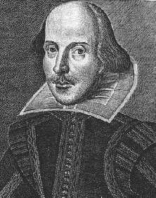
William Shakespeare

Slide 2
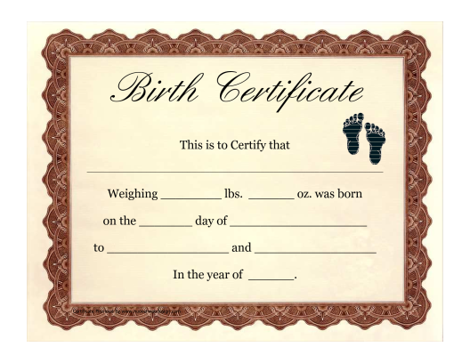
Biography
No records of Shakespeare’s exact birthdate, but assumed that he was born around 1564.
Also assumed that he attended grammar school, but no exact records that state when and where he went.
After the records of his wife and children, Shakespeare falls off the map for approximately 7 years.
Assumed that he left his family for the life in theatre
No records of his death, but assumed that he passed around 1616.

Slide 3
Language
Shakespeare has contributed more words, phrases, and expressions into the English language than any other writer.
Shakespeare is known for occasionally reversing the word order by rearranging the subject and verb.
The correct way is SVO (subject verb object)
Shakespeare tends to reverse it VSO (verb subject object)
Example: I went to the store vs. Went to the store I did.

Slide 4
Words from Shakespeare
Addiction
Cold-blooded
Dishearten
Eventful
Manager
Arch-Villain
Assassination
Bedazzled
Belongings
Swagger

Slide 5
Language cont.
Shakespeare wrote is his plays primarily in blank verse
Unrhymed lines of iambic pentameter (5 unstressed syllables followed by 5 stressed syllables)
Sonnet format!
Shakespeare is known for including allusions and puns into his writing
https://www.youtube.com/watch?v=I5lsuyUNu_4

Slide 6
The Play Breakdown
Shakespeare’s plays are divided into 5 acts
Act I: exposition and conflict
Act II: rising action and complications
Act III: turning point
Overall determines the play’s direction
Act IV: falling action
Act V: climax and conclusion
Setting up the play
Who does and does not get along?!

Slide 7
Shakespeare’s Plays: Comedies
All’s Well That Ends Well
As You Like It
Comedy of Errors
Love’s Labour’s Lost
Measure for Measure
Merchant of Venice
Merry Wives of Windsor
Midsummer Night’s Dream
Much Ado about Nothing
Taming of the Shrew
Twelfth Night
Two Gentlemen of Verona
Winter’s tale

Slide 8
Plays cont: Histories
Henry IV, Part I
Henry IV, Part II
Henry V
Henry VI, Part I
Henry VI, Part II
Henry VI, Part III
Henry VIII
King John
Pericles
Richard II
Richard III

Slide 9
Plays Cont: Tragedies
Antony and Cleopatra
Coriolanus
Cymbeline
Hamlet
Julius Caesar
King Lear
Macbeth
Othello
Romeo and Juliet
Timon of Athens
Titus Andronicus
Troilus and Cressida

Slide 10
Characteristics of Tragedies
Characters | Dramatic Conventions
Tragic Hero: the protagonist, or central character | Soliloquy: speech given by a character alone; exposes characters thought and feelings to the audience
Antagonist: hostile force opposing the protagonist; can be a character or group of characters | Aside: character’s remark that others on stage do not hear, but is meant for the audience to know
Foil: character whose personality and attitude contrast those of another character; emphasizes another character’s traits | Dramatic Irony: when the audience knows more than the characters; helps build suspense
 | Comic Relief: humorous speech intended to relieve the tension; also heightens the seriousness of the main action by contrast

Slide 11
Romeo and Juliet
Romeo and Juliet is one of Shakespeare’s most famous tragedies
The Montagues | The Capulets | Others
Lord Montague: father | Lord Capulet: father | Prince Escalus: ruler of Verona
Lady Montague: mother | Lady Capulet: mother | Mercutio: friend of Romeo
Romeo: son of Monatgue | Juliet: daughter of Capulets | Friar Laurence & John: priests
Benvolio: nephew and friend of Romeo | Tybalt: nephew of Lady Capulet | Count Paris: young nobleman
Balthasar: servant of Romeo | Nurse: Juliet’s nurse | Apothecary: pharmacists
Abram: servant to Montagues | Sampson & Gregory: servants | An officer, Chief Watchman, and Three Musicians
 | Peter: servant to the nurse
 | An old Man: part of Capulet family

Slide 12
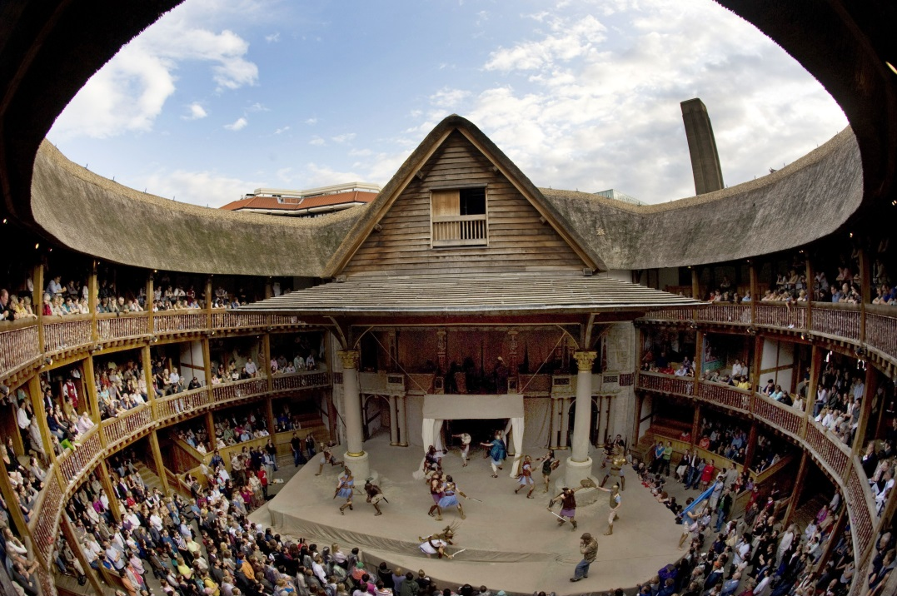
Shakespeare time
Shakespeare’s Time-
The Elizabethan Age
He lived in England
during the flowering of
intellectual activity known
as the Renaissance.
Basic to Renaissance thinking was a new emphasis on the individual and the freedom of choice.
Music during this time was Baroque. It was extremely ornate and overly complicated.
Queen Elizabeth ruled England during Shakespeare’s time. She loved the theater!

Slide 13
Shakespeare theatre
The Globe Theater was built in 1598 in the Bankside District of London.
Open-air octagonal amphitheater could seat 3000.
All shows happened during the day.
No scene changes, so props and costumes were important.
The pit or the yard was the floor surrounding the stage where groundlings stood.
In 1613 the Globe burned down. In 1642 a new one was built, but was closed by the Puritans.
A new Globe was opened in 1997 by the current queen, Elizabeth II.

Slide 14
Activity
In groups of 3-4, choose (2) shows or movies that you have all seen. Then, create a table on one sheet of paper, like this:
Write the appropriate characters from your show/movie underneath each category. Ex:
When you have finished, answer the question:
How does the conflict between the protagonist and the antagonist lead to action of the story?
Tragic Hero | Antagonist | Foil
Atticus | Ewell’s | Scout, Jem & Dill

