Slide 1
The Importance of Outlining

Slide 2
Prewrite/ Drafting = Outlining!
What is an outline?
A general description or plan for something
Examples:
Architects use blueprints BEFORE building a structure.
Chefs write out a menu BEFORE printing out the menu for the night .
Writers use outlines BEFORE starting a piece.
Movie directors use scripts, multiple takes, and scenes BEFORE releasing a movie

Slide 3
Ten Reasons to Outline
It makes writing the actual piece EASIER.
When you start writing the piece, all of you points, details, statistics, quotes, etc are already written down!
It makes reading EASIER.
Papers are easier to read when they have structure and flow.
It makes your message more memorable.
If your paper flows, the reader can focus more on your MESSAGE, instead of trying to decipher what you are saying or getting confused

Slide 4
Ten Reasons to Outline cont.
4. It helps ensure you are thorough.
What do I mean by thorough??
5. It helps limit errors.
It is hard to make an error in your piece if you have already caught in when writing your outline.
6. Ensures symmetry
Your piece has a SHAPE. Everything flows and makes sense. Everything is pieced together.

Slide 5
Ten Reasons to Outline cont.
7. Keeps you focused.
Creating an outline for one idea keeps you working and focused on that ONE idea.
8. Motivation!
Once you have finished the outline, then you can move onto writing the actual piece.
9. You develop a regular writing process
Similar to annotating, it will become a HABIT that will help improve all of your writing.

Slide 6
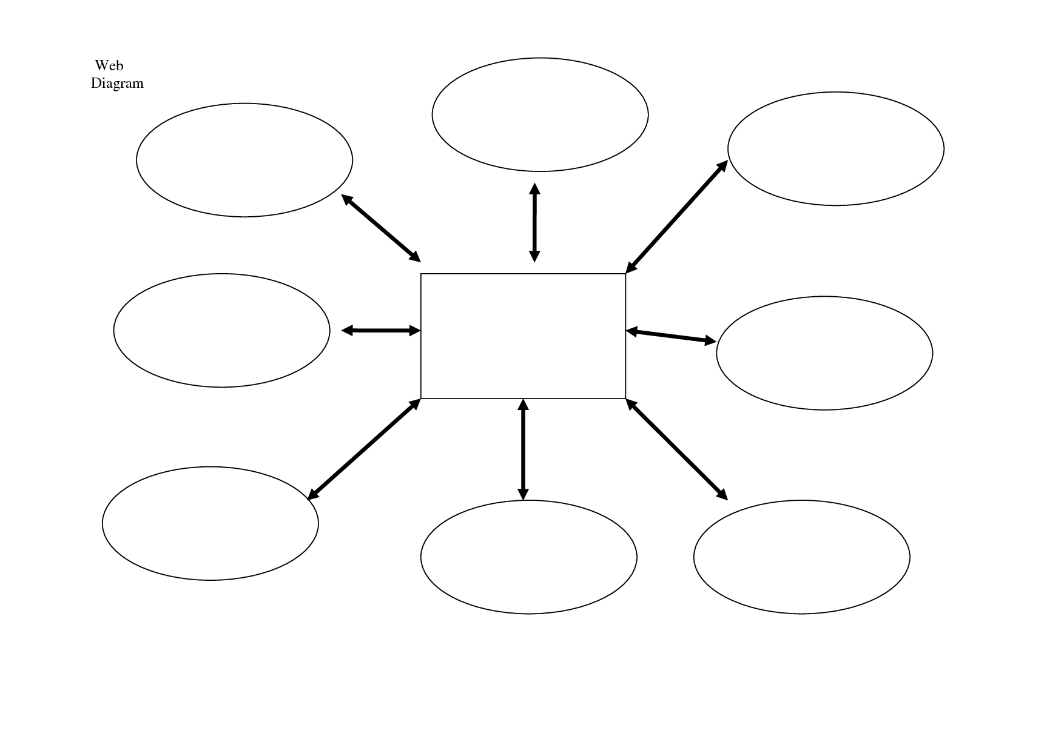
Ten Reasons to Outline cont.
10. BECAUSE IT IS FUN!
Use DIAGRAMS, colors, circles, highlighters, arrows – anything that will help guide you when you start writing the piece.

Slide 7
Steps to an outline
Look at prewriting ideas and decide on a topic
Which topic can I write about?
Which topics are the least interesting?
Which one will interest my audience?
What is the prompt for this piece?
What is the purpose of the piece?
Who is the audience?
Peers? Online? Miss Mendenhall?
What is my main idea!?
Go hand – in - hand

Slide 8
Steps cont.
2.Once you have decided on a
topic, it is time to start
gathering information!
Do I need to conduct research?
How much research do I need to do?
Do I need specific quotes?
Statistics?
What needs to be explained to my reader?
If you are writing about horseback riding and I do not know anything about horses, you might have to explain some stuff.

Slide 9
Steps cont.
3. After gathering information, decide the order of which to present your data, details, etc.
Which details need to be in the first paragraph and introduced first?
What background information needs to be provided with these details?
Which details relate back to the main idea

