Slide 1
Grammar

Slide 2
Capitalization
Names, titles, movies, books, papers, songs, languages, religions, and name brands
Examples:
Yesterday, I went to Target with Aunt Lilly.
Principal Potter
The Suite Life of Zach and Cody
Spanish, French, English
Christian, Roman Catholic
Ford Mustang, Pontiac Firebird
Should NOT be capitalized: articles & conjunctions!
a, an, the, for, and, nor, but, or, yet, so (FANBOYS)

Slide 3
Fragmented Sentences
A fragmented sentence is an incomplete sentence
Lacks either a subject (noun), a verb, or does not communicate a complete thought.
More examples:
Saw that it was time to leave →
lacks a subject or noun
The king and all his men →
lacks a verb
Before we went to soccer practice →
incomplete thought

Slide 4
Proper Citation
What is textual evidence?
Adding a specific phrase, sentence, or paragraph from a text into your written piece, in order to illustrate an idea and make connections
Why include evidence?
Adds legitimacy to a point
Provides support for an argument
When to use textual evidence?
Formal papers or if a response requires it

Slide 5
How to include textual evidence
ALWAYS introduce the evidence/ quote
Wrong: “Why fit in when you were born to stand out.” – Dr. Suess
Right: One motto that I used in high school was: “Why fit in…” by Dr. Suess.
Right: Growing up, everyone worries about fitting in, but Dr. Suess says “ Why fit in…”
The textual evidence should always fit and flow right into your response.

Slide 6
Different types of evidence
Short evidence: under three lines
According to some, dreams express “profound aspects of personality” (Foulkes 184), though others disagree.
Parenthetical citation: authors LAST name page number of the evidence- no comma or anything between the two
Smooth transition
No punctuation
Punctuation goes AFTER parenthetical citation

Slide 7
Different types etc.
Long evidence: four + lines = block quote
Set up the quote
Indent ONE inch underneath paragraph
The entire block quote is indented one inch
Dean treats Heathcliff poorly and dehumanizes him throughout her narration:
“They entirely refused to have it in bed with them, or even in their room, and I had no more sense, so, I put it on the landing of the stairs, hoping it would be gone on the morrow. By chance, or else attracted by hearing his voice, it crept to Mr. Earnshaw's door, and there he found it on quitting his chamber.” (Bronte 78)
Punctuation goes BEFORE parenthetical citation to keep block quote original to text in source

Slide 8
Types of Paragraphs
Descriptive Paragraph
Set the scene
Introduce a character
Create a mood
Appeal to the senses: sight, smell, hear, touch, and taste
Narrative Paragraph
Tells a story
Fiction and nonfiction
Answers the questions: who, what, where, when, and how

Slide 9
Types of paragraphs cont.
3. Persuasive Paragraph
presents an argument
Convincing readers on certain opinions and points of view
Appeal to emotion or reason or BOTH
Uses examples, facts, statistics, EVIDENCE
4. Informative/ Expository paragraph
Presents or explains facts and ideas
Used to define terms, give directions, and explain processes

Slide 10
Parts of a paragraph
Main Idea: the paragraph’s focus ← all sentences in paragraph relate back to this = SUPPORT
Topic Sentence: direct state of the main idea for the paragraph
All other sentences SUPPORT the topic sentence and overall main idea

Slide 11
Types of Topic Sentences
Different methods to use for topic sentences:
Writing the main idea as a clear problem in one sentence
Ex: One problem for the beginning guitar student is deciding what type of guitar to play.
General statement then REVISE to make more specific
Ex General Statement: Some types of guitars are easier to learn than others. – YOU TRY and make this more specific
Ex Specific Restatement: The electric guitar is easier to learn than the acoustic guitar.
Main idea in the form of a question
Ex: What is the best type of guitar for a beginning student?

Slide 12
Transitions
Transitions are used to help writing flow and to prevent choppy sentences.
They could be used when writing:
Sentence to sentence
Paragraph to paragraph
Page to page
No matter what you are writing, you want it to FLOW and that is what transition are there for- use the sheet provided in class to help guide your writing.

Slide 13
Context Clues
Write down the following sentences and use context clues to try and define the bolded words.
“The man rose with hospitable haste, and opening the door, was heard condoling with the new arrival. The new arrival also condoled with himself…”
“Mr. White took the paw from his pocket and eyed it dubiously. ‘I don’t know what to wish for, and that’s a fact.’”
“There was no reply; the old woman’s face was white, her eye staring, and her breath inaudible; on the husband’s face was a look such as his friend sergeant might have carried into his first action.”

Slide 14
Irony
Situational Irony: the contrast between what a character or the reader expects and what actually happens
Example: A marriage counselor files for divorce.
Verbal Irony: the contrast between what someone says and what he/she means (aka sarcasm)- usually similes are used
Often used in television
Example: He was as nice as lions are to their prey.
Dramatic Irony: the contrast between what a character knows and what the reader or audience knows
In a scary movie, a character will walk into a house thinking it is empty but the viewers know that the killer is inside the house.

Slide 15
Conjunctions
A conjunction connects words or groups of words of equal importance in a sentence
Two biggest: AND & BUT
FANBOYS (for, and, nor, but, or, yet, so)
Correlative Conjunctions: words pairs that join a group of words
If you have one, then you should have the other
Both…and, neither…nor, either…or, not only…but also, whether…or
Example: You will not only hear your favorite song but also see the performer

Slide 16
Subordinating Conjunctions
Subordinating Conjunctions introduce subordinating clauses – parts of a sentence that cannot stand alone – and join them to independent clauses
Common Subordinating Conjunctions
After, although, as, as if, as though, because, before, even though, if, in order that, since, so that than, unless, until when, where, whereas, while
Ex: The band waited while the director checked the lighting.

Slide 17
Practice
Directions: Write a small paragraph describing one example of foreshadowing from the short story, The Ransom of Red Chief. Be sure to use one example of textual evidence in your response. (4-5 sentences)
Use the different parts that we just learned!!

Slide 18
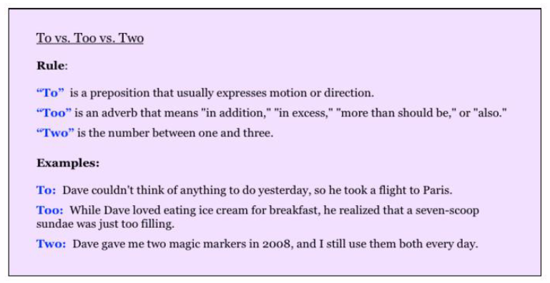
To vs. Too vs. Two

Slide 19
To vs. Too vs. Two Practice
I planned on going two the store, but it started to rain.
After the rain passed, I thought my car would start but it was to cold.
I decided too take an Uber, but my app would not work.
Since the app would not work, I walked two the RTA stop.
When I finally got too the store, they only had one can of soup but I needed too.

Slide 20
Nouns
What is a noun?
Person: musicians, audience, students, Billy Bob
Place: theatre, school, Great American Ball Park
Thing: instruments, chairs, desk, bat
Idea: joy, freedom, inspiration
A common noun is the general name of a person, place, thing, or idea.
A proper noun refers to a specific person, place, thing or idea.

Slide 21
Pronouns
A pronoun can replace a noun or another pronoun.
Example:
The boy and his dog walked down the street.
They walked down the street and to the park.
Possessive Pronouns show ownership or relationship -words in parenthesis are possessive.
Example: Sonia delivered her famous monologue.
 | Singular | Plural
First Person | I, me (my, mine) | We, us (our, ours)
Second Person | You (your, yours) | You (your, yours)
Third Person | He, him, she, her, it (his, her, hers, its) | They, them (their, theirs)

Slide 22
Noun Practice
Write down the following sentences, then underline the nouns. Mark whether they are proper or common.
The Rock and Roll Hall of Fame in Cleveland draws visitors from all over the world.
This unusual museum honors musicians for their creativity.
Fans spend days satisfying their curiosity by watching videos and listening to recordings.
The public can also view rock and roll artifacts.
The museum is definitely a place to visit!

Slide 23
Its vs. It’s
Its- even though there is not apostrophe, it refers to possession
Example: When I was walking, there was a dog barking like crazy; I am not sure what its problem was.
It’s- with the apostrophe means combined “it is” or “it has”
Example: It’s been a long time since I have seen my best friend.

Slide 24
Their vs. There vs. They’re
Their- possessive pronoun they
Example: They left their cell phone in my class, so I made them tell a joke to get it back.
There- adverb meaning “in” or “at that place.”
Example: I am not sure why he put the plant over there.
They’re- contraction of they are
Example: They’re going to the movies after the football game, but I was not invited.

Slide 25
Practice Sentences
Read the following sentences and determine if it is using the correct “its vs. it’s” and “there vs. their vs. they’re.” If correct, write correct. If incorrect, rewrite the sentence correctly.
The Great American Ball Park is the best diamond to catch a game; there are none like it around!
It’s comfortable atmosphere allows viewers to relax and prop they’re feet up.
When I was five, their was no other place I wanted to be!
Now that I am older, their are a couple things that have changed.
Its a fun stadium, but the Reds are not as good as they used to be.

Slide 26
What is a Verb?
A verb expresses an action, a condition, or a state of being.
The two types of main verbs are: linking and action
Linking: links the subject of a sentence to a word in the predicate.
Action: expresses action
Example: to run, to walk, to see, etc.

Slide 27
Action Verbs
An action verb express action. This action may be physical or mental.
Example:
The band marches onto the field. (physical)
The audience expects a great performance. (mental)
Transitive Verbs: when an action verb appears with a direct object.
Ande kicks the ball like a champion.
Olivia plays the trumpet like a godess.
Intransitive Verb: when an action verb does not have a direct object.
She travels around the country with a team.
They laughed at the clown.

Slide 28
Linking Verbs
Tip: if you can substitute is, are, was, or were for a verb, you know it is a linking verb.
links the subject of a sentence to a word in the predicate.
Two groups of linking verbs:
To be- is, am, are, was, were, been, and being
Verbs that express condition- look, smell, feel, sound, taste, and grow
Examples:
The instruments are shiny.
The students seemed bored during class.
Some verbs can be action or linking
Action
Linking
We felt the seat cushions
They felt dry
We tasted the popcorn
It tasted salty

Slide 29
Auxiliary Verbs
Some Auxiliary Verbs can also be used as main verbs, like has.
Combine with verbs to create verb phrases.
Can also be called helping verbs.
Verb phrase may be used to express a particular tense of a verb or to indicate that an action is directed at the subject.
Examples:
The stadium is filled to capacity.
We should save a seat for Fatima.
Common Auxiliary Verbs:
Be
Can
Have
May
Might
Must
Shall
Should
Will
Would

Slide 30
Simple subject & predicate
A sentence has two basic parts: a subject and a predicate
Subject: tells what the sentence is about
Predicate: what the subject does or what happens to the subject
Examples:
Gary went for a run to get ready for the race.
The weather was colder than Gary expected.
subject
predicate
subject
predicate

Slide 31
Complete Subject & Predicate
A complete subject includes the simple subject and all the words that modify it, or tell more about it.
A complete predicate includes the verb and all the words that modify it, or tell more about it.
Every word in the sentence is either apart of the complete subject or the complete predicate.
Examples:
The newborn puppy fell over trying to go up the stairs.
Laylonni decided to order a new skirt for the party.
subject
predicate
subject
predicate

Slide 32
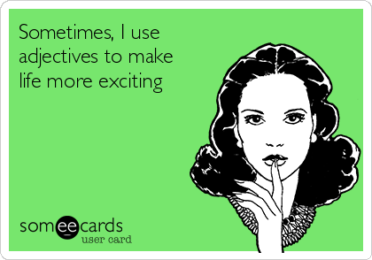
Adjectives
Adjectives: modifies or limits the meaning of the noun or pronoun.
Example: We saw the famous singer at the legendary Carnegie Hall.
An adjective explains:
what kind: famous, squeaky, green, large, loud
which one: this, that, these
how many: one, several, three, eleven
how much: some, more, less
Articles: refer to a general group of people, places, things, or ideas
These include: a, an, and the
Example: Phil borrowed the camera from his mother.
She is a real peach.

Slide 33
Kinds of Sentences
There are four major types of sentences:
Declarative: expresses a fact, wish, intent or feeling. ALWAYS ends with a period
Example: My favorite color is grey.
Interrogative: makes a question and always ends with a question mark
Example: What is your favorite color?
Imperative: expresses command, request, or direction. Usually ends with a period but if the command or request is strong, it might end with an exclamation point.
Example: Do not tell me your favorite color is something other than grey.
Exclamatory: expresses a strong feeling and always ends with an exclamation point
Example: Grey is the best color ever made!

