Slide 1
Annotating & Close Reading

Slide 2
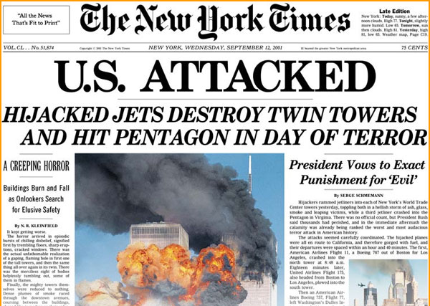
Purpose of annotating & what to look for
Adding notes to a text while reading, in order to provide explanation or comments for better understanding and overview
What to look for:
Newspaper- where is the article coming from? Does it have an effect on the articles?
Section- how is this article going to effect the reader? Ex: lifestyle, business, etc
Title- what is the title going to tell you about the article/ text?

Slide 3
What to look for cont.
Headline- specifically for newspapers/ magazine articles, briefly describing what the article is going to cover.
Grabs your attention! READ ME
Subheading- deeper explanation providing specifics on the article, tying the headline and the article together
Now that you are interested, here are the specifics…

Slide 4
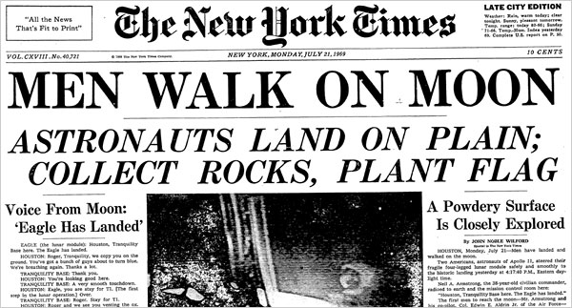
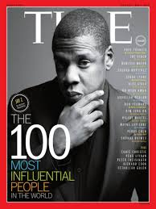
What to look for cont.
Type- what kind of text is it? Essay? Novel? Article?
What does the type of text tell us about the information?
Article: inform us about a specific situation/ issue/ what is going on in the area
Essay: explaining an issue/ situation, and providing a detailed and organized argument on how to resolve the issue OR simply sharing a story

Slide 5
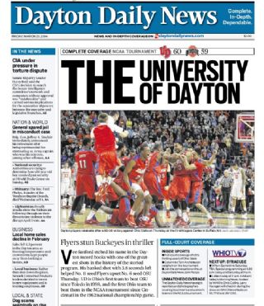
What to look for cont.
Who are the main people involved?
Someone famous?
An animal?
Someone in the area?
Most articles include a quote or story from a person effected by the situation in the article→ offers a personal touch for readers to connect with
Ex: for this newspaper, the article might include a story from someone who attended the basketball game

Slide 6
What to look for cont.
When was this published? Whether it is a novel, article, or essay, the date matters!
What is going on? Based on the headline and the subheading, what is the text going to be telling us? INFORM!

Slide 7
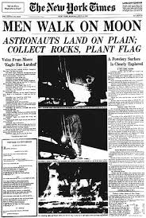
Is this a recent article?
Why would someone read this article?

Slide 8
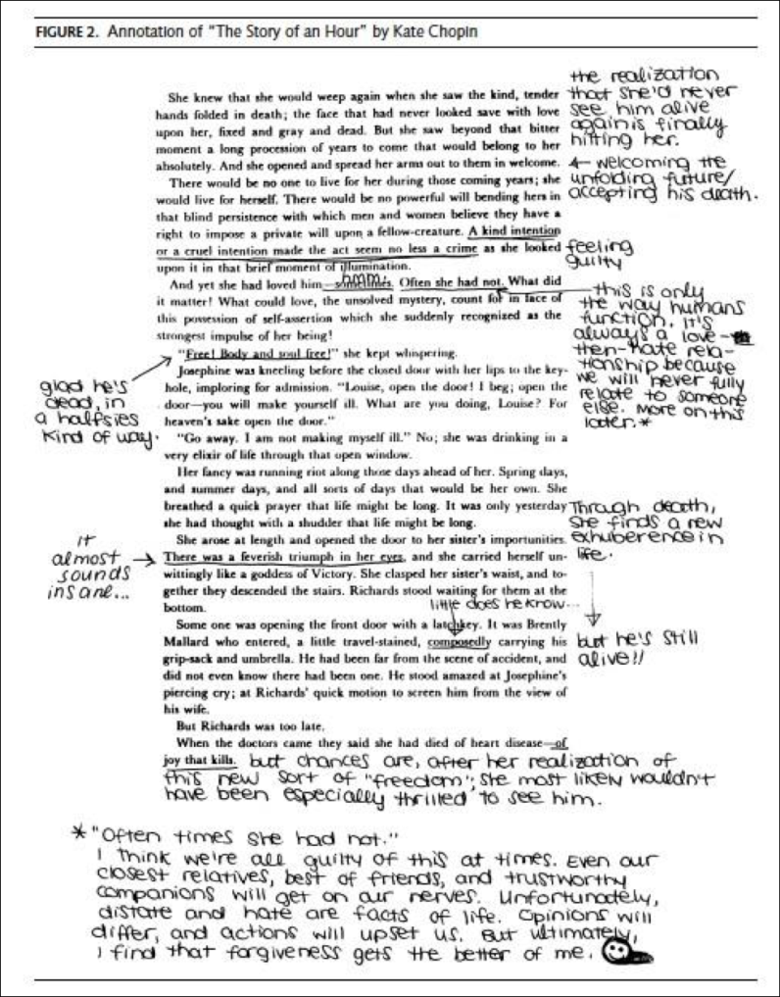
What to look for cont.
Summarizing paragraphs in the margins
What is the first paragraph telling me? Why is it so important? Does it set up the rest of the text? What do I know based on just the opening paragraph?
Why is this useful?

Slide 9
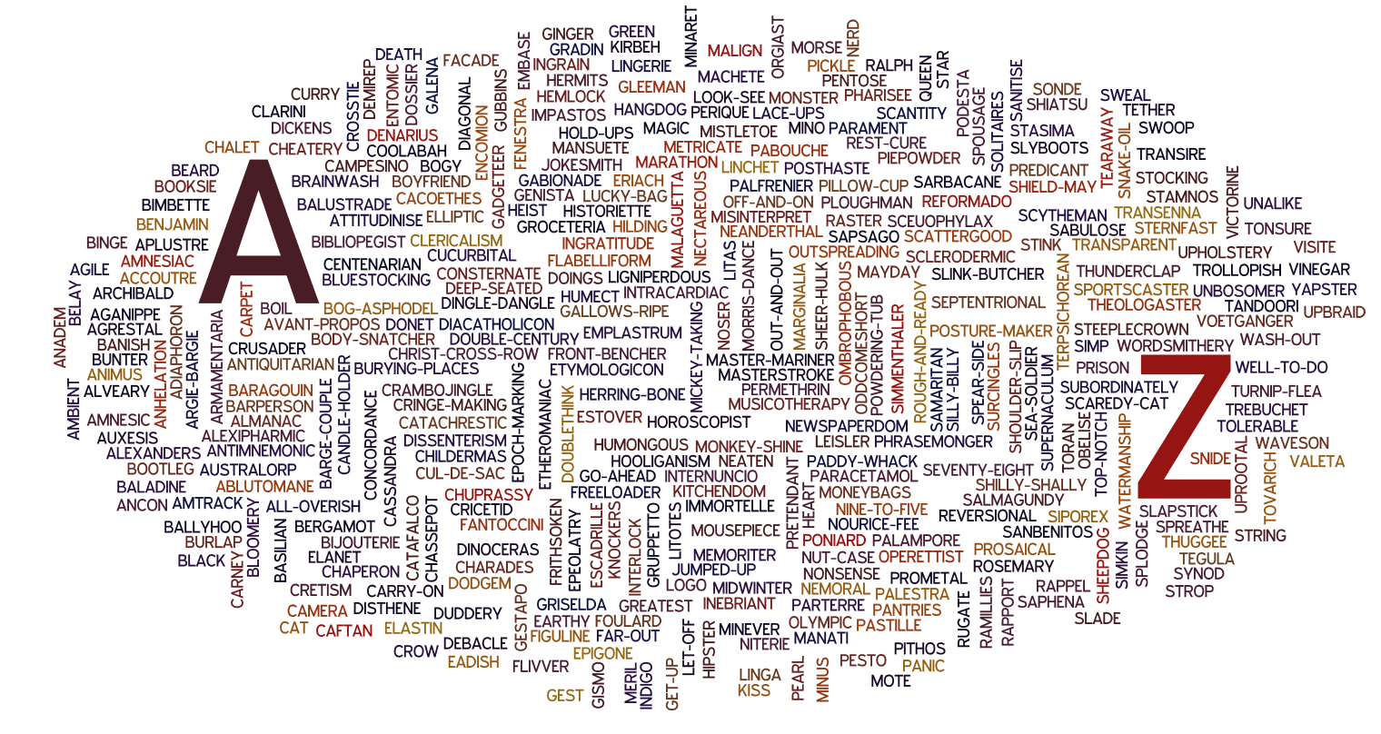
What to look for cont.
WORDS!- what words are confusing to you? Any terms that you have not seen before? MAKE A NOTE!
Underline and look it up
later!

Slide 10
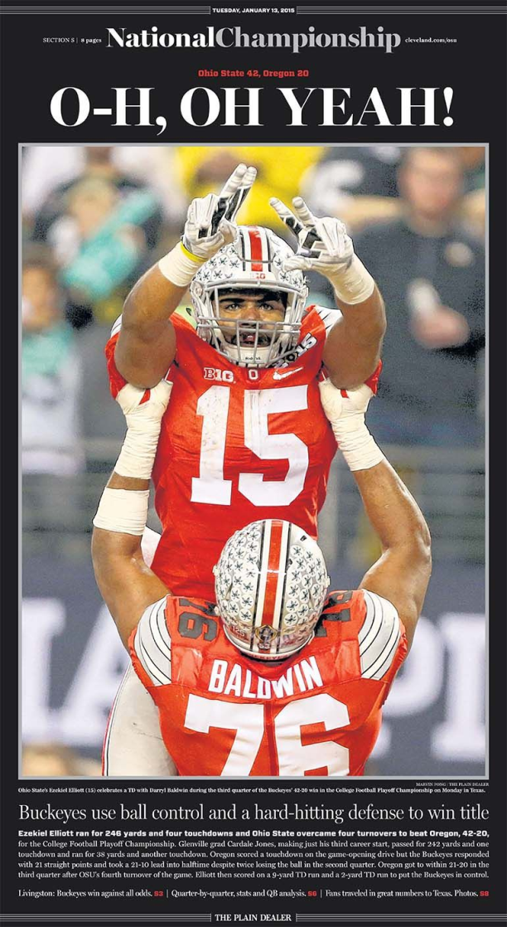
Tone vs mood
Tone- how the author feels/ the emotions and feelings occurring in the text
Mood- how you as the reader perceive the text and how it makes you feel

Slide 11
Code it
During your annotations, create a code that makes sense to you and helps you CLOSE read QUICKLY and EFFECTIVELY.
Examples:
Main idea/ thesis* = underlined with a * noted in the margin
Supporting details and background information = squiggly line
Unclear words/ vocabulary/ words to know = circle
Interesting/ Shocking idea* = note in the margin, boxed around the thought
Questions? = question mark by the thought? Arrows in the margins with ideas and possibilitie
Highlighters are fun! Color-code your thoughts and ideas if it helps

